Slide 1

SMART WASTE-AI-POWERED COMMUNITY WASTE MANAGEMENT SYSTEM
TEAM DETAILS
NAME: DHANASRI K / 211423104121
NAME: DEVADHARSHINI J / 211423104115
BATCH NUMBER : A21
DOMAIN:FULL STACK DEVELOPMENT
DATE : 29/10/2025
GUIDE NAME & DESIGNATION
DR.ALIMA BEEVI
ASSISTANT PROFESSOR

Slide 2
AGENDA
Introduction: Overview of the Smart Complaint Management System project.
Objectives: Define the goals and purpose of the system. Literature Review: Study of existing complaint management solutions.
Problem Statement: Identify issues in current manual complaint handling.
System Architecture & Diagrams: Visual representation of system workflow and design.
Modules Description: Explanation of each module’s role and functionality.
Methodology: Process followed for design and implementation.
Testing: Validation of system performance and functionality.
Conclusion: Summary of outcomes and future improvements.

Slide 3
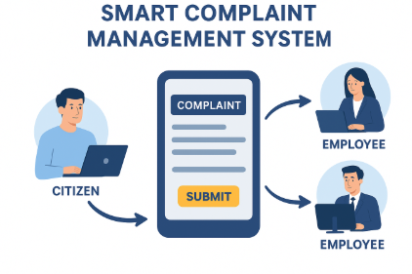
ABSTRACT
The Public Complaint Management System allows citizens to easily report public issues to government authorities.
It provides separate dashboards for citizens, employees, and admin to manage and track complaints efficiently.
The system supports real-time email notifications and a feedback feature after issue resolution.
Built using Node.js and MongoDB, it ensures fast, transparent, and user-friendly grievance handling.
Technology Utilized:
Frontend: React
Backend: Node.js, Express.js
Database: MongoDB
Notifications: Email (Nodemailer)

Slide 4
INTRODUCTION
The Smart Complaint Management System is designed to simplify how citizens register and track their complaints.
It acts as a bridge between citizens, employees, and administrators, enabling smooth communication and quick issue resolution.
The system allows citizens to submit complaints online, attach evidence (like images), and monitor progress in real time.
Administrators can manage employees, view complaints and monitor departmental performance.
Employees can view complaints relevant to their department and update progress efficiently.
The platform ensures transparency, accountability
Built using React.js (frontend), Node.js & Express (backend), and MongoDB (database) for seamless performance.
Designed to make complaint handling digital, faster, and more organized, reducing manual effort and paperwork.

Slide 5
OBJECTIVE
To create a digital platform for easy and quick complaint registration by citizens.
To streamline communication between citizens, employees, and administrators.
To ensure transparency and accountability in complaint handling and resolution.
To allow real-time tracking of complaint status and progress.
To reduce manual work and eliminate paper-based complaint systems.
To enable admins to monitor employee performance
To build a user-friendly interface that can be accessed easily.
To provide a centralized database for storing and managing complaint records securely.
To promote faster issue resolution through clear workflows.

Slide 6
LITERATURE REVIEW
Author(s) & Year | Key Contribution / Summary
Singh, R., & Sharma, P. (2021) | Smart Complaint Management System Using Web-Based Applications. Proposes a web-based system to automate complaint registration and tracking for improved public service efficiency.
Yadav, S., & Choudhary, A. (2020) | Implementation of Complaint Redressal System for Public Services. Focuses on developing a simple and efficient redressal platform to handle public service complaints.
Patel, K., & Desai, M. (2019) | E-Governance: A Smart Complaint Management Framework for Urban Development. Introduces a framework for managing urban complaints under e-governance initiatives.
Sharma, P., & Jain, R. (2020) | Automated Complaint Management System for Improving Customer Satisfaction in Government Services. Discusses automation tools to streamline complaint handling and improve satisfaction.
Rathore, H., & Aggarwal, N. (2018) | Development of an Online Complaint Management Portal for Government Services. Describes the creation of a user-friendly portal for managing public grievances.

Slide 7
LITERATURE REVIEW
Author(s) & Year | Summary
Islam, M. R., & Rahman, A. (2019) | Blockchain Based Complaint Management System for Enhancing Trust in E-Governance. Proposes blockchain integration to ensure transparency and trust in complaint management.
Tripathi, V., & Patel, R. (2021) | Real-time Complaint Management System Using Cloud and AI Technologies. Suggests a real-time system leveraging AI and cloud for faster response and resolution.
Mehta, S., & Garg, A. (2020) | Improving Public Service Delivery Through Smart Complaint Handling Systems. Focuses on digital tools to improve government service delivery through efficient complaint handling.
Shah, D., & Shah, P. (2021) | Intelligent Complaint Monitoring and Resolution System for Customer Service. Introduces an AI-based monitoring and resolution platform to enhance customer service.
Ramesh, P., & Priya, K. (2019) | Enhancing Complaint Resolution Efficiency in Government Offices Using Automation Tools. Studies automation to increase complaint resolution speed and efficiency.

Slide 8
LITERATURE REVIEW
Author(s) & Year | Summary
Kaur, J., & Singh, S. (2020) | Smart Complaint Management System for University Campuses Using IoT and Cloud Computing. Applies IoT and cloud solutions to manage university-level complaints.
Thomas, J., & Mathew, S. (2020) | Design of a Secure Complaint Portal with Real-Time Tracking and Feedback Mechanism. Presents a secure complaint system with live tracking and feedback integration.
Banerjee, A., & Chatterjee, S. (2019) | Machine Learning Techniques for Efficient Complaint Handling in Government Platforms. Explores ML algorithms for improving classification and resolution of public grievances.
Sharma, K., & Mishra, S. (2021) | Data-Driven Complaint Resolution System for Enhancing Public Trust. Emphasizes data analytics for better decision-making in grievance management
Verma, R., & Prasad, K. (2021) | Development of a Web-Based Complaint Monitoring System Using Artificial Intelligence. Describes an AI-driven platform for real-time complaint tracking.

Slide 9
PROBLEM STATEMENT
Slow and Manual Handling: Complaints are processed manually, causing delays. This reduces overall efficiency and response time.
Lack of Transparency: Users cannot track the status of their complaints easily. Organizations also struggle to prioritize and manage complaints effectively.
Poor Communication: Interaction between users and authorities is inconsistent. Miscommunication often leads to unresolved or repeated complaints.
Delayed Resolution: Complaints take longer to resolve due to manual workflows. Slow responses affect service quality and stakeholder satisfaction.
User Experience Problems: Citizens find it hard to submit complaints with full details. Frustration reduces trust in governance and slows civic engagement.

Slide 10
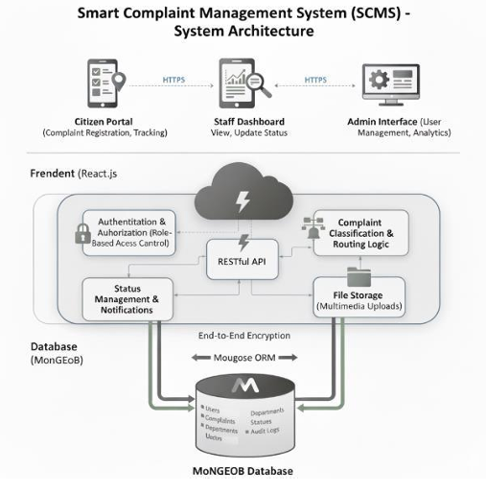
ARCHITECTURE DIAGRAM

Slide 11
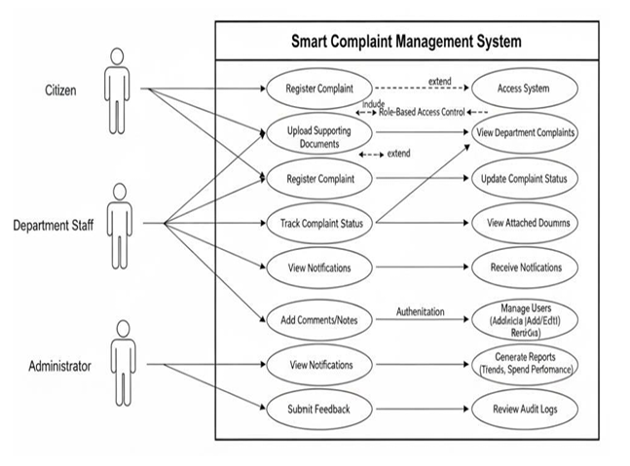
Usecase Diagram

Slide 12
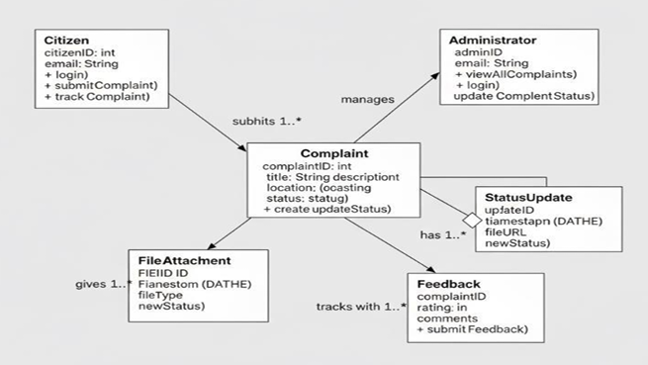
Class Diagram

Slide 13
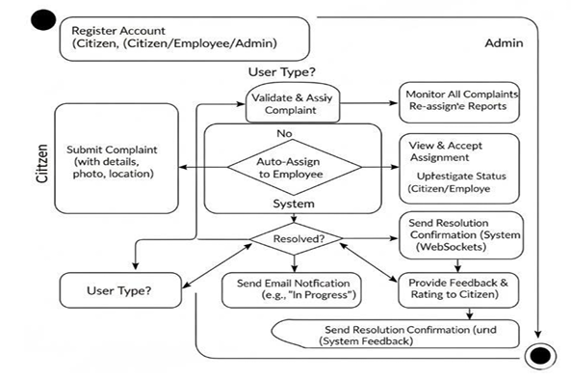
Activity DIAGRAM

Slide 14
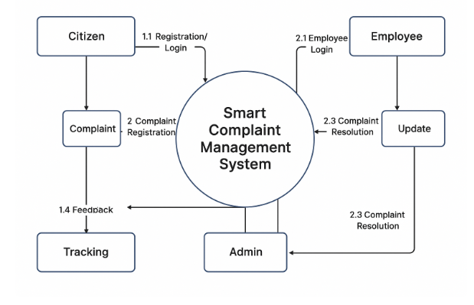
DATA FLOW DIAGRAM

Slide 15
MODULES
Citizen Module: Register/login, submit complaints, and track status.
Employee Module: View department complaints and update statuses.
Administrator Module: Manage users, monitor complaints, and generate reports.
Complaint Management Module: Automatic classification, routing, and duplicate detection.
Geolocation & Multimedia Module: Capture location and upload images.
Notification & Tracking Module: Real-time alerts and progress monitoring.
Security & Database Module: Role-based access and secure centralized storage.

Slide 16
METHODOLOGY
System Design: The system is built using a role-based architecture with separate dashboards for Citizens, Employees, and Administrators.
Workflow & Automation: Complaints are submitted by citizens, automatically classified, and routed to the relevant department. Duplicate complaints are detected to avoid redundancy.
Implementation (MERN Stack):
Frontend: React.js for interactive user interfaces.
Backend: Node.js and Express.js for server and API handling.
Database: MongoDB stores complaints, users, and media securely.
Tracking & Notifications: Real-time status updates and alerts keep citizens, employees, and admins informed of complaint progress.
Testing & Maintenance:All modules are tested for functionality, performance, and security. Continuous monitoring ensures smooth operation.

Slide 17
TESTING
Functional Testing:
Verify that all modules (Citizen, Employee, Admin) perform their intended functions.
Check complaint submission, status updates, dashboards, and notifications.
Role-Based Testing:
Ensure that Citizens, Employees, and Administrators can access only their permitted features.
Database Testing:
Verify secure storage of complaints, user information, and media files.
Check integrity and consistency of stored data.
Automation & Workflow Testing:
Test automatic complaint classification, routing, and duplicate detection.
Verify that complaints reach the correct department without manual intervention.
Performance & Security Testing:
Ensure system handles multiple concurrent users.
Test authentication, authorization, and data privacy.

Slide 18
TEST CASE
Module | Test Case | Expected Result
Citizen | Register/login & submit complaint | User can login & complaint saved successfully
Employee | View & update status | Status updates reflect on dashboard
Admin | Add/delete users & generate reports | User management and reports work correctly
Complaint Management | Automatic routing & duplicate check | Complaints routed correctly, duplicates blocked
Notification | Status change alert | Citizen receives real-time notification

Slide 19
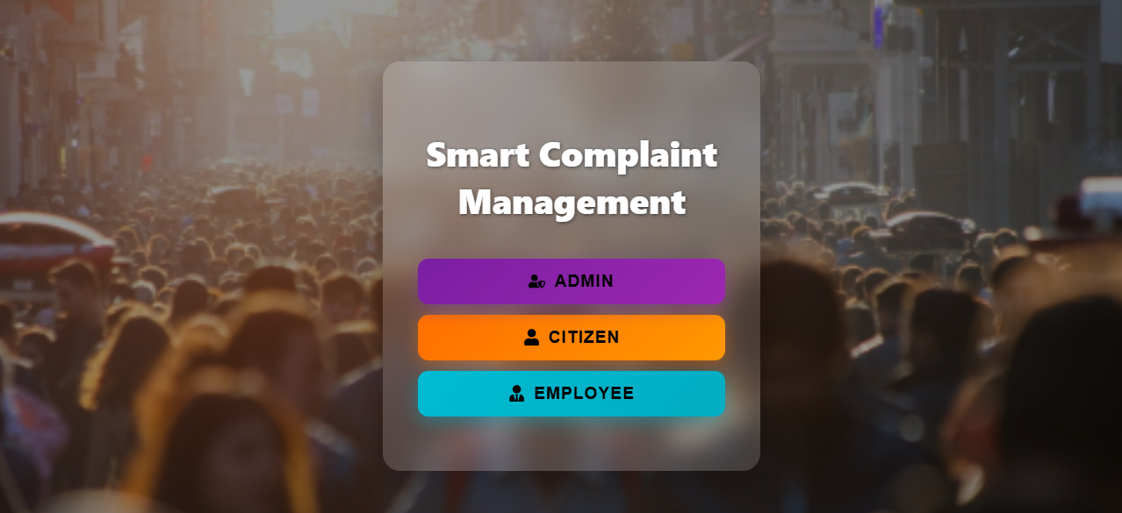
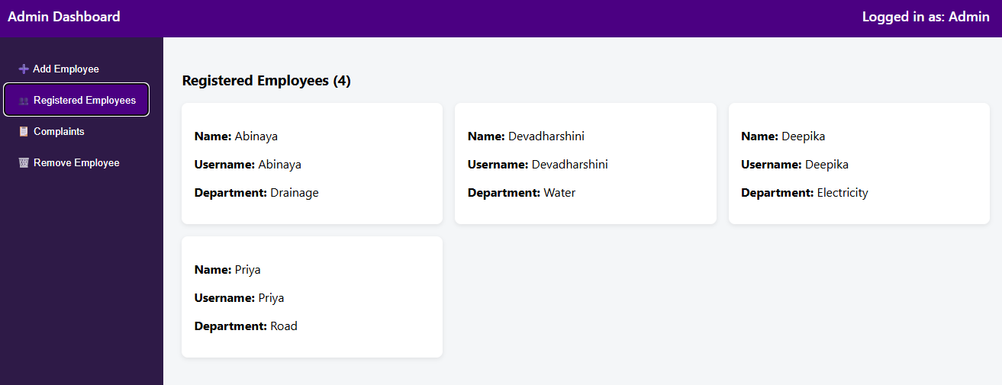
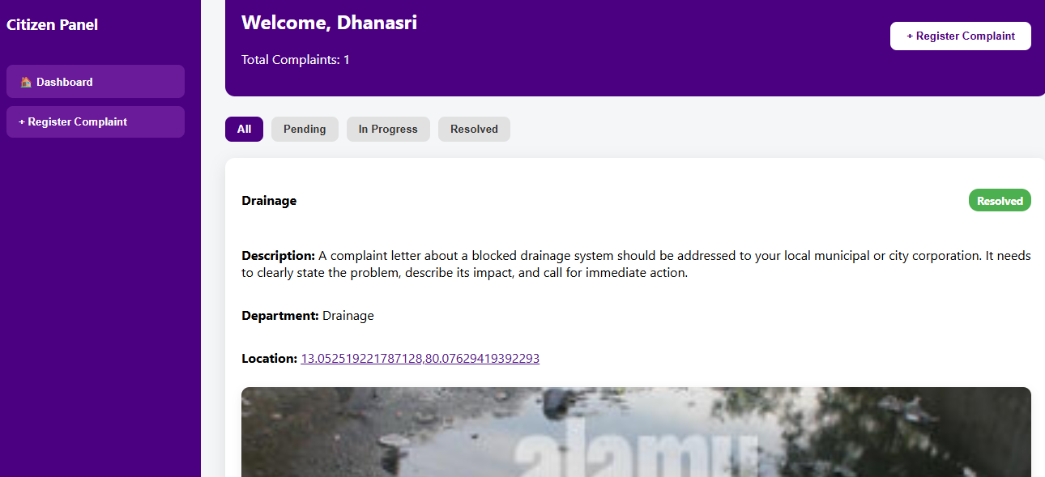
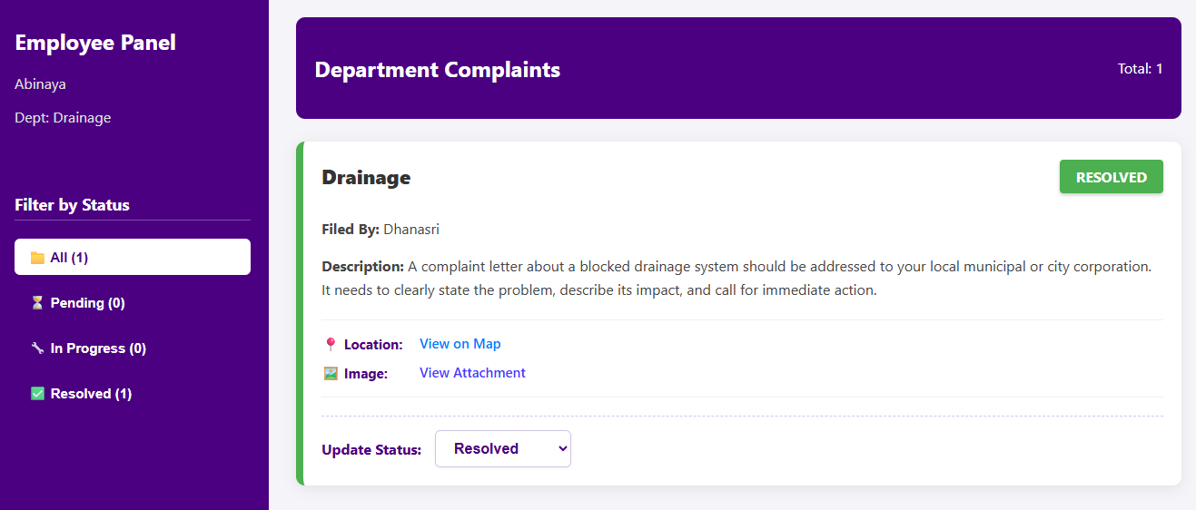
SCREENSHOTS

Slide 20
CONCLUSION
The SCMS provides a fully automated, transparent, and efficient complaint management solution.
Citizens can easily submit complaints with detailed information and multimedia attachments.
Employees and administrators can track, manage, and resolve complaints effectively through dashboards.
Features like automatic classification, duplicate detection, geolocation, and notifications improve efficiency.
Overall, the system enhances public grievance redressal, promotes accountability, and fosters trust between citizens and authorities.

Slide 21
FUTURE WORK
Develop native mobile applications for Android and iOS to increase accessibility
Implement advanced analytics dashboards to identify recurring issues and improve decision-making.
Introduce AI-based complaint categorization and prioritization for faster resolution.
Enable multi-authority collaboration for complaints spanning multiple departments.
Add automated updates and real-time notifications to keep citizens informed at every stage.

Slide 22
REFERENCES
Singh, R., & Sharma, P. (2021). Smart Complaint Management System Using Web Based Applications. International Journal of Advanced Research in Computer Science, 12(3), 58–64. https://doi.org/10.26438/ijarcs/v12i3.5864
Yadav, S., & Choudhary, A. (2020). Implementation of Complaint Redressal System for Public Services. International Journal of Innovative Research in Technology, 7(11), 112–117.
Patel, K., & Desai, M. (2019). E-Governance: A Smart Complaint Management Framework for Urban Development. Procedia Computer Science, 152, 137–142. https://doi.org/10.1016/j.procs.2019.05.021
Sharma, P., & Jain, R. (2020). Automated Complaint Management System for Improving Customer Satisfaction in Government Services. Journal of Management Information Systems, 36(2), 195–204.
Rathore, H., & Aggarwal, N. (2018). Development of an Online Complaint Management Portal for Government Services. International Journal of Computer Applications, 179(7), 7–13. https://doi.org/10.5120/ijca2018915612
Islam, M. R., & Rahman, A. (2019). Blockchain Based Complaint Management System for Enhancing Trust in E-Governance. International Journal of Advanced Computer Science and Applications, 10(8), 112–120. https://doi.org/10.14569/IJACSA.2019.0100815
Tripathi, V., & Patel, R. (2021). Real-time Complaint Management System Using Cloud and AI Technologies. Journal of Cloud Computing: Advances, Systems and Applications, 10(1), 45–52.

Slide 23
REFERENCES
8. Shah, D., & Shah, P. (2021). Intelligent Complaint Monitoring and Resolution System for Customer Service. International Journal of Data and Network Security, 9(1), 22–28.
9. Ramesh, P., & Priya, K. (2019). Enhancing Complaint Resolution Efficiency in Government Offices Using Automation Tools. Journal of Software Engineering and Applications, 12(5), 213–221.
10. Kaur, J., & Singh, S. (2020). Smart Complaint Management System for University Campuses Using IoT and Cloud Computing. International Journal of Computer Networks and Communications Security, 8(7), 1–7.
11. Thomas, J., & Mathew, S. (2020). Design of a Secure Complaint Portal with Real Time Tracking and Feedback Mechanism. International Journal of Information Technology and Management, 19(4), 305–313.
13. Banerjee, A., & Chatterjee, S. (2019). Machine Learning Techniques for Efficient Complaint Handling in Government Platforms. IEEE Access, 7, 100824–100833. https://doi.org/10.1109/ACCESS.2019.2936754
14. Sharma, K., & Mishra, S. (2021). Data-Driven Complaint Resolution System for Enhancing Public Trust. International Journal of Intelligent Systems and Applications, 13(6), 45–54

Slide 24
THANK YOU

